Slide 1

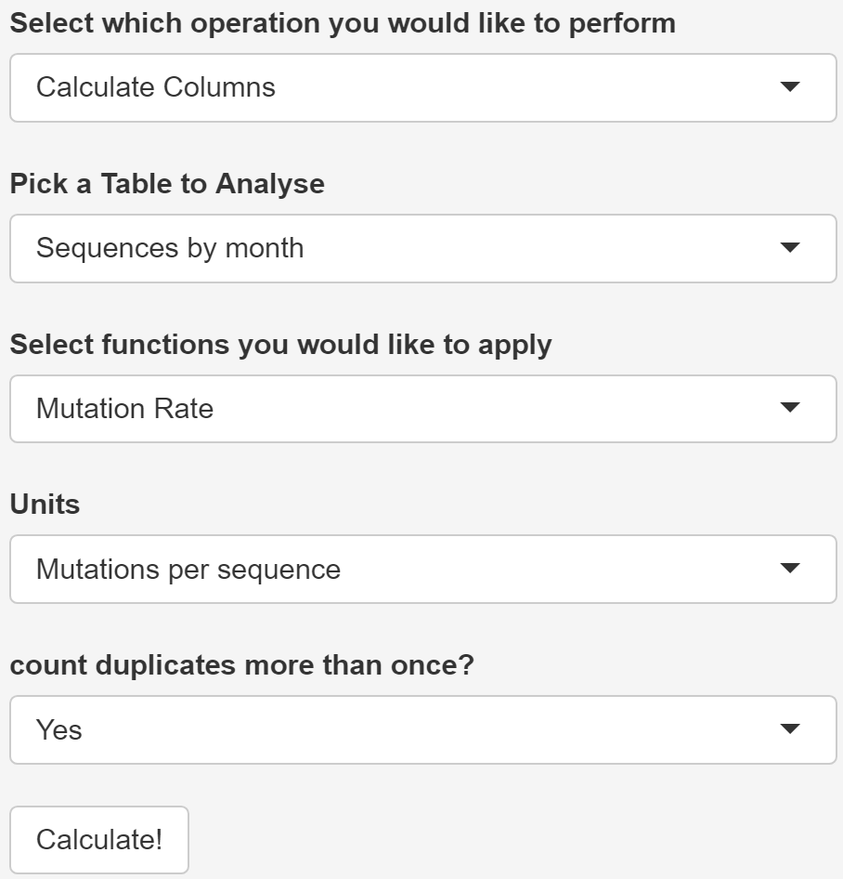
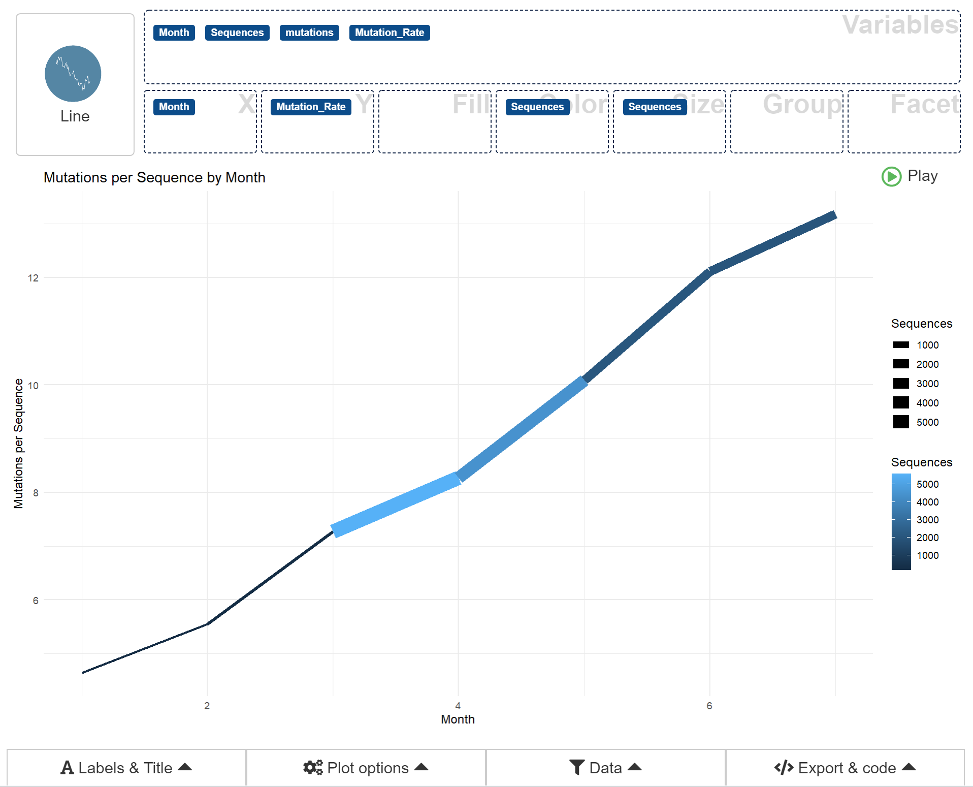
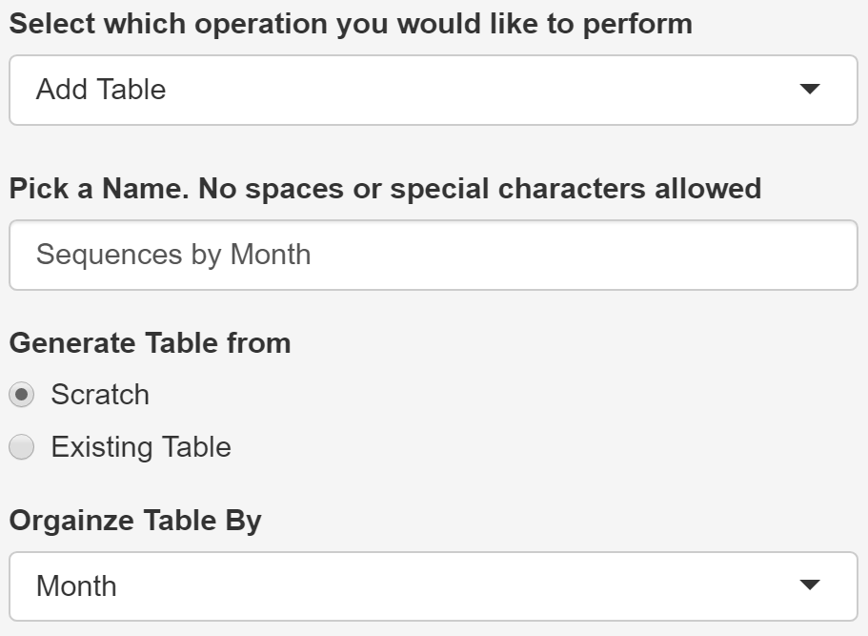
COVID-19 Mutation Analyzer
Jacob Geisberg: Cell and Molecular Biology, Computer Science
Advisor: Aaron Maus, Department of Computer Science
Introduction & Problem statement
As You can see, creating a table is not that hard, and there are a number of options to choose from depending on your needs. As an added bonus, the website will give you a preview of your table when it is completed!
Next, we need to compute the average number of mutations in each sequence for each month in our data set. Luckily, the website has just such a built-in function!
Much like creating a table, the website will display the result of the calculations or inform you if there was a problem.
Finally, we can take advantage of the website’s drag and drop interface to create a graphic displaying our results!
Since COVID-19 burst onto the international scene in December 2019, researchers from all corners of the globe have been pouring time and resources into studying countless aspects of the disease. The unplanned and unprecedented rush to generate and process all that data has led to significant data quality challenges as well and missing resources. My website plugs one of those holes by providing a free, public, and simple way to analyze mutations in COVID 19 genomes through its custom analyses and drag and drop visualizations.
Methods/approach
In order to get the data into user’s hands it must first by gathered, processed and transformed. Accordingly, the data used in the COVID-19 Mutation Analyzer goes through the following pipeline:
COVID-19 sequences
Mutation data tables
Website
Analysis
Fig. 1 COVID-19 genomic sequences are pulled from the NCBI virus database. Sequences are then aligned to reference sequence using local Smith-Waterman algorithm. Alignments are processed for mutations, and the data is stored in tables. Finally, the completed tables are fed to website for analysis.
Once data is on the website, it can be utilised by users in a myriad of ways to aid in exploratory data analysis and visualization. Here is an outline of the main features of the website and what each does.
Add Table: Groups data into a new table to be analysed according to a user-selected variable
Filter: Lets the user dynamically filter entries in a table across all existing variables in the table.
Data Pulled: Controls the overall database that existing entries are compared to for calculations
Calculate: Lets users pick from a variety of premade analyses to perform on their data
Graph: Drag and drop interface for creating customized graphs
Display: Renders customized data tables sortable by any column
By dragging the “Month” and “Mutation_Rate” buttons into the X and Y Axis bins and changing the plot type to “Line” in the upper left corner, we are able to generate a line graph showing that average number of mutations per sequence has been growing linearly. As a bonus, we can also add the number of sequences per month into the size and color bins to show that our conclusion holds up in spite of dramatic variations in sample size over the 7 month period.
By presenting COVID-19 genomic data in a format that allows for rapid analysis and visualization, we hope to quality of life for researchers and others conducting exploratory analysis, thereby facilitating discovery. However, much work is still needed to improve data sharing across all COVID-19 related domains. Additionally, the website could be improved through automated data collection and other features.
Sample Use Case
To Showcase some of the website’s features, we will demonstrate how it can be used to track genetic changes in COVID-19 over time. Specifically, we will calculate the average number of mutations per sequence in each month from January to July 2020. The first step is to create a new table that is organized by month since that is the unit we will be investigating.
Discussion
References
https://github.com/dreamRs/esquisse
https://www.ncbi.nlm.nih.gov/labs/virus/vssi/#/virus?SeqType_s=Nucleotide&VirusLineage_ss=SARS-CoV-2,%20taxid:2697049
https://biopython.org/

